Slide 1

Microsoft Foundry
From prototype
to operated service
Build with GitHub Copilot.
Run, evaluate and improve in Foundry.
Sridhar Arrabelly
Customer deep dive + live demo | 50 minutes + Q&A
Notes:
[TIME]
00:00-00:45. Welcome. Advance to slide 2 by 00:45.
[DO]
Leave the cover visible. Look at the audience rather than the laptop. Start the
presentation clock only after completing the pre-show setup. It is at the front
of this script and at the end of this slide's PowerPoint note, outside the timed hour.
[SAY]
Hello, everyone. I'm Sridhar. Today I want to show you Microsoft Foundry
through one complete story, rather than take you through a catalogue of features.
We will build with GitHub Copilot, run an agent using the Copilot SDK in Foundry,
and examine what it takes to evaluate, release and improve that agent.
The question I would like you to keep in mind is this: when an assistant gives
a convincing answer, what evidence would you need before putting it in front of
your customers or colleagues?
We will spend about fifty minutes on that journey and keep the final ten for
your questions.
[TRANSITION - SAY]
Let me start with the difference between getting an answer and operating a service.
[DO]
Advance to slide 2.
[PRE-SHOW SETUP - COMPLETE BEFORE STARTING THE CLOCK]
The following setup is included here so the notes are self-contained. Once ready, return to the welcome at the top of this note.
[DO]
Open PowerPoint in Presenter View. Keep these windows ready, in this order:
1. A PowerShell terminal in the demo directory.
2. VS Code with instructions.md, volt/domain.py, core.jsonl and regression.jsonl.
3. The recorded evidence HTML, already loaded.
4. The Foundry agent, Traces, and completed native evaluation.
5. GitHub Actions with the blocked, passing and live-release runs.
Close unrelated tabs and notifications. Use large terminal/editor text. Do not
display .env files, azd env get-values, or an unfiltered azd ai agent show
response; those can expose configuration values.
[COMMAND - RUN BEFORE PRESENTING]
Set-Location C:\Users\sarrabelly\Documents\GitHub\foundry-showcase\demo
$versions = Get-Content evidence\rehearsal-index.json -Raw | ConvertFrom-Json
$baseline = [string]$versions.baseline_version
$improved = [string]$versions.improved_version
$release = Get-Content evidence\release.json -Raw | ConvertFrom-Json
if ([string]$release.version -ne $improved) { throw "Release pointer and rehearsal version differ. Rehearse before presenting." }
$sessionDir = Join-Path (Get-Location) ("evidence\presenter-" + (Get-Date -Format 'yyyyMMdd-HHmmss'))
New-Item -ItemType Directory -Path $sessionDir | Out-Null
$baselineReport = Get-Content evidence\baseline.json -Raw | ConvertFrom-Json
$candidateReport = Get-Content evidence\candidate.json -Raw | ConvertFrom-Json
$nativeEvaluation = Get-Content evidence\foundry-evaluation.json -Raw | ConvertFrom-Json
$referenceBaseline = Get-Content evidence\missing-batch-baseline.json -Raw | ConvertFrom-Json
$referenceImproved = Get-Content evidence\missing-batch-improved.json -Raw | ConvertFrom-Json
Start-Process (Resolve-Path 'presentation\Recorded demo evidence.html')
Start-Process $nativeEvaluation.report_url
Start-Process $versions.intentional_blocked_workflow
Start-Process $versions.passing_quality_workflow
Start-Process $versions.release_workflow
[CHECK]
The retained versions should be 2 and 4 for this package. The completed reports
should show 7/9 and 9/9. If the resources or version IDs have changed, reconcile
them before presenting; do not substitute a guessed version.
For the live path, warm the exact versions before the room opens. These commands
invoke the real model and incur usage. They write new files, leaving the recorded
fallback intact. Skip them if you have deliberately chosen the recorded path.
[COMMAND - LIVE-PATH WARM-UP, NOT ON STAGE]
python scripts\demo.py ask "Check Volt Charge 65 batch CH-0926 for a recall." --version $improved --out "$sessionDir\warm-improved.json"
python scripts\demo.py ask "I have a Volt Charge 65. Is it safe?" --version $baseline --out "$sessionDir\warm-baseline.json"
[CHECK]
Confirm both complete successfully. In Foundry, use the project and agent
bookmarks from docs\DELIVERY.md. Pre-open one version-4 trace with its tool spans.
For recorded traces, select the last seven days or a custom window including
8 November 2026; an increasingly narrow "last 24 hours" window can hide them.
If the portal's navigation differs, find the page now, not during the session.
If authentication, networking or the model is unavailable, choose the recorded
path before starting. Say so at the first demonstration. Do not attempt IAM,
package installation, deployment or portal troubleshooting in front of the room.

Slide 2
The story
One customer request. A complete operating story.
Build quickly. Prove deliberately. Learn after release.
1
2
3
4
5
Build
Connect
Prove
Release
Improve
Copilot + code
A useful assistant
Business tools
Checkable facts
Cases + traces
Measured behaviour
Version + evidence
An explicit gate
Observed failure
A reviewed new test
The strength is in the connections—not the number of features we can show.
Volt & Co | Synthetic demonstration | Microsoft Foundry
02
Notes:
[TIME]
00:45-02:00. Do not explain product features individually here.
[DO]
Point once from Build to Improve. Pause briefly on Prove and Release.
[SAY]
Most demonstrations begin with a question and end with an impressive response.
That is useful, but it leaves several important questions unanswered.
Where did the facts come from? Did the agent use the right tool? If we change its
instructions tomorrow, how do we know we have not broken something that worked
today? And when a user asks a question we did not anticipate, how does that
observation become a better next version?
Those are the connections we will follow. First we build something useful.
Then we connect it to facts we can check. We prove specific behaviours, make an
explicit release decision, and use operational evidence to improve the next
candidate.
That is where Foundry becomes more than a place to try a model. It gives us
runtime and lifecycle capabilities around the application. We still own the
business logic and the policies that decide what is acceptable.
Today, one small customer journey will make those responsibilities visible.
[TRANSITION - SAY]
Our customer for that journey is a fictional electronics retailer called Volt & Co.
[DO]
Advance to slide 3.

Slide 3
One use case throughout
Meet Volt & Co
A fictional electronics assistant that recommends the cheapest product that works.
“A charger for my
Volt Book 14.
Under EUR 50.”
Volt Charge 30
30W | EUR 19.90
Underpowered
Volt Charge 65
65W | EUR 39.90
Compatible + in budget
The device requires 65W.
Volt Charge 100
100W | EUR 59.90
Above budget
Then the same customer asks about a recall. Missing evidence becomes the next test.
Volt & Co | Synthetic demonstration | Microsoft Foundry
03
Notes:
[TIME]
02:00-04:00. Establish the data and boundaries once; refer back later.
[DO]
Point to the customer's request, then the three charger rows. Pause for three
seconds after the question below; do not open a long discussion.
[SAY]
Volt & Co wants an assistant that helps customers choose the cheapest product
that actually meets their needs.
Our customer has a Volt Book 14 and wants a charger for less than fifty euros.
Looking at these three options, which one should the assistant recommend?
[DO]
Pause for three seconds. If someone chooses the cheapest, acknowledge the price
and point to the 65W requirement. Otherwise continue without waiting for a reply.
[SAY]
The thirty-watt charger is cheapest, but it does not meet the laptop's
sixty-five-watt requirement. The one-hundred-watt charger is compatible with the
power requirement, but it is over budget. That leaves the sixty-five-watt model
at thirty-nine euros ninety.
This is deliberately simple. We can check the answer against the data rather
than argue about whether it sounds persuasive.
The same assistant can also check recall information for a particular product
batch. That adds an important distinction: not knowing the batch is not the
same as knowing that there is no recall.
All names, prices, specifications and recall records in this demonstration are
fictional. The tools are read-only. We are not placing orders, taking payments
or changing customer records.
That gives us a useful journey with clear boundaries: find a product, verify
compatibility, and handle missing information honestly.
[TRANSITION - SAY]
Now let's place that one journey inside the development and operating lifecycle.
[DO]
Advance to slide 4.

Slide 4
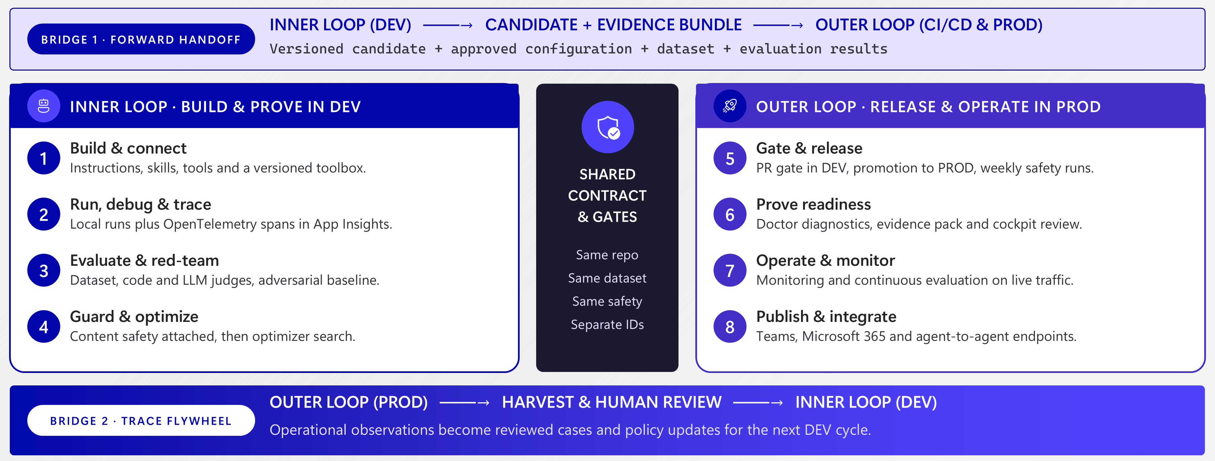
The lifecycle
One continuous system: inner and outer loop
Reference lifecycle: two loops, connected by versioned and reviewed evidence.
Volt & Co | Synthetic demonstration | Microsoft Foundry
04
Notes:
[TIME]
04:00-07:00. Allow time for the audience to inspect the diagram.
[DO]
Trace the left-hand loop, the upper forward bridge, the right-hand loop and
finally the lower return bridge. Do not read every box.
[SAY]
This is the mental model for the rest of the session. There are two loops and,
just as importantly, two bridges between them.
The inner loop, on the left, is the developer's learning cycle. We define the
behaviour, connect the tools, run the agent, inspect what happened, evaluate it
against expectations, and improve the candidate.
The important word is candidate. A developer saying "this looks better" is not
yet a release decision.
Look at the upper bridge. What moves forward is not simply a copied prompt.
It is a versioned candidate with evidence: which configuration was used, which
cases were evaluated, what passed, what failed, and what boundaries were checked.
That is what makes a change reviewable.
The outer loop, on the right, is the repeatable release and operating process.
It applies the gates, puts an identified version into service, and watches what
that version does when it receives requests.
Now follow the lower arrow back to development. This is the connection that is
often missing. An operational observation is reviewed, the expected behaviour
is defined, and a new test becomes part of what the next candidate must prove.
That human review is important. A response found in a trace is not automatically
the right answer, and a model-generated finding is not automatically the right
fix.
This picture is the broader reference architecture. We will not demonstrate
every capability on it. Our compact implementation uses local development and
a hosted demo target. It is not a separately isolated customer production
environment.
What we will demonstrate is both evidence bridges: candidate to release, and
observed behaviour back to a test. Keep those two arrows in mind. They connect
everything that follows.
[TRANSITION - SAY]
With the lifecycle clear, let's separate the roles of GitHub, the Copilot SDK
and Foundry in the implementation.
[DO]
Advance to slide 5.

Slide 5
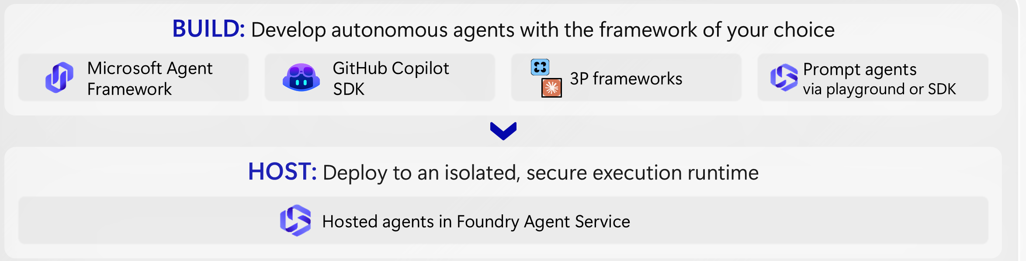
Architecture
Build in GitHub. Run and improve in Foundry.
Copilot for development. Copilot SDK for runtime. Foundry for hosting and lifecycle.
Inspect every run
Score before release
Learn from traffic
Volt & Co | Synthetic demonstration | Microsoft Foundry
05
Notes:
[TIME]
07:00-09:00. Explain the responsibility boundary, not the whole platform catalogue.
[DO]
Point to GitHub Copilot SDK in the BUILD row, then Hosted agents in the HOST row,
then the three lifecycle phrases along the bottom.
[SAY]
There are two uses of Copilot in this story, and I want to distinguish them.
First, GitHub Copilot helps the developer write and understand the application
code, tests and workflow. That is the development experience.
Second, the GitHub Copilot SDK is the harness inside this particular application.
It manages the agent interaction with the model and the tools we have exposed.
It is not the same thing as handing our customers an unrestricted coding assistant.
In this implementation, the customer-facing runtime has three allowlisted,
read-only business tools. It is not given general shell or filesystem access.
Foundry then hosts that application and provides the endpoint and the surrounding
lifecycle capabilities. The model also runs through Foundry, authenticated with
Microsoft Entra. We have not embedded a GitHub token in the business agent.
The graphic shows that hosted agents are not limited to this one framework. We
chose the Copilot SDK because it makes our GitHub-to-Foundry story concrete.
The framework choice does not remove our responsibility for the tool logic,
permissions, evaluation coverage or release policy.
The managed Foundry Toolbox and API Management are useful extension points,
but they are not configured in this sample. Our three tools are packaged with
the agent. I will distinguish what we actually run from the broader platform
architecture.
[TRANSITION - SAY]
Let's move from the architecture to the customer request. The infrastructure
is already prepared, so we can spend the time on behaviour and evidence.
[DO]
Advance to slide 6. Keep it visible during the first transition sentence.

Slide 6
Live demo 1
Watch the answer—and the path that produced it
One request, three business checks, inspectable evidence.
LIVE DEMO 01
09:00-16:00 | live request + trace
Customer
Catalog
Compatibility
Answer
Volt Book 14
Budget: EUR 50
30W at EUR 19.90
65W at EUR 39.90
Reject 30W
Confirm 65W
Volt Charge 65
EUR 39.90
The trace links the request, tool arguments, returned facts and response.
Next: explaining one execution is not the same as proving consistent behaviour.
Volt & Co | Synthetic demonstration | Microsoft Foundry
06
Notes:
[TIME]
09:00-10:00 transition; 10:00-12:15 shopping; 12:15-14:15 recall;
14:15-15:45 trace; 15:45-16:00 return to slides.
[DO]
Switch to the prepared terminal. The preflight variables from the front of this
script must already be set. Keep the recorded evidence HTML one click away.
Give each live request a 30-second on-stage budget. If it is still pending, use
the IF SLOW wording below and the recorded path for the rest of this segment.
Do not paste another command into a terminal that is still busy.
[SAY]
We are now leaving the slide and sending a request to the deployed agent.
The data is synthetic, but this request will use the actual Copilot SDK harness,
Foundry model and hosted runtime.
I am selecting the corrected version explicitly. That keeps the behaviour tied
to a known candidate rather than whatever happens to be the latest version.
[COMMAND]
python scripts\demo.py ask "Find the cheapest charger for my Volt Book 14 under EUR 50." --version $improved --out "$sessionDir\shopping.json"
[WHILE WAITING - SAY IF NEEDED]
While it works, notice what we have not done. We have not told the model which
charger to choose. We have given it a task and access to a small set of business
functions. The interesting evidence will be the facts those functions return
and how the final recommendation relates to them.
[EXPECT]
Successful command; decision recommend; product VC-C65; EUR 39.90 in the answer.
Tool evidence includes catalog lookup and compatibility for the selected item.
The exact wording and number/order of calls can vary. Do not narrate a call
that is not present.
[DO]
Only after a successful command, use the following to show the answer and tool
records without scrolling through the full envelope.
[COMMAND]
$shopping = Get-Content "$sessionDir\shopping.json" -Raw | ConvertFrom-Json
$shopping.output | Format-List
$shopping.tool_calls | ConvertTo-Json -Depth 10
[SAY]
The recommendation is the sixty-five-watt charger. What makes that answer useful
is not just the product name: it meets the power requirement and the budget.
Here is the tool evidence behind it. The catalog supplies the prices and
specifications. The compatibility check supplies the relationship to the device.
We can inspect the path instead of treating the final sentence as our only
source of confidence.
Now let's stay with the same retailer and ask the support question.
[COMMAND]
python scripts\demo.py ask "Is my Volt Charge 65 from batch CH-0722 safe to use?" --version $improved --out "$sessionDir\recall.json"
[EXPECT]
Decision recalled; product VC-C65; batch CH-0722; getRecallNotices appears in
tool_calls. The response refers the fictional customer to human support.
This sample does not create a support ticket or perform a real handoff.
[COMMAND]
$recall = Get-Content "$sessionDir\recall.json" -Raw | ConvertFrom-Json
$recall.output | Format-List
$recall.tool_calls | ConvertTo-Json -Depth 10
[SAY]
This batch is marked as recalled in the fictional register. The response directs
the customer to support rather than inventing a repair workaround.
Notice the scope of the answer: a product and a batch, backed by a returned
record. A catalog match is not a blanket safety guarantee. That distinction
will matter again when the batch information is missing.
[DO]
Switch to the pre-opened Foundry Traces view for the agent. Select the rehearsed
version-4 request if the new trace has not arrived yet. Open the request details
and the custom tool span. If using a recorded trace, use the next sentence.
[SAY]
I am opening a captured rehearsal trace here so we do not wait for telemetry
ingestion. The live request and its tool output are in the terminal; this view
shows how we investigate an execution afterward.
The trace gives us an operational record: the invocation, the instrumented
tool work and the timing. It is not a window into a model's private chain of
thought. We use the observable execution to answer practical questions:
which operation ran, with what input, and what happened next?
[IF SLOW - SAY]
The live service is taking longer than the time I have allocated. I will switch
to the captured rehearsal result from the same project and identify it as
recorded, rather than make the room wait.
[DO]
Use presentation\Recorded demo evidence.html and the candidate report.
Do not reclassify the recorded request as live. If the command is still running,
leave it running in its terminal while showing the capture; do not issue another
identical request or overwrite the output file.
[IF DIFFERENT RESULT - SAY]
This request did not produce the expected result. I will not call it a pass.
We would inspect this execution and retain it as evidence. For the planned
walkthrough, I will use the clearly labelled rehearsal capture.
[RETURN TO SLIDES - SAY]
We have now seen a useful answer and the evidence behind one execution.
That still leaves a bigger question: does the behaviour hold across a set of cases?
[DO]
Return to PowerPoint and advance to slide 7 by minute 16.

Slide 7
Evaluate
From a convincing answer to measurable evidence
Recorded rehearsal: the same nine synthetic cases, compared across two versions.
Baseline · version 2
7/9
BLOCK
+
+
+
+
+
+
+
-
-
Corrected · version 4
9/9
PASS
+
+
+
+
+
+
+
+
+
The two failed cases both omitted the batch code.
Small synthetic-case results—not a population accuracy estimate or safety certification.
Volt & Co | Synthetic demonstration | Microsoft Foundry
07
Notes:
[TIME]
16:00-17:00. Keep the interpretation precise.
[DO]
Point to the two missing cells in the baseline row and then the corrected row.
Do not describe the result as a general accuracy percentage.
[SAY]
Here is the recorded comparison from rehearsal. The baseline passed seven of
nine cases; the corrected version passed all nine.
The two failures both involved missing batch information. That gives us a
specific engineering question, not simply a disappointing average score.
These are nine synthetic cases that we deliberately chose. They are not a
statistically representative measure of every future customer request, and
nine out of nine is not a safety certification.
Their value is that the expectations are visible, the same cases are used for
the comparison, and we can connect each result to an identified agent version.
We can now ask whether a change improved the behaviour we intended without
silently breaking the cases that already worked.
[TRANSITION - SAY]
To make that evidence useful, we also need the right kind of check for each question.
[DO]
Advance to slide 8.

Slide 8
Define what good means
Three checks. Three different jobs.
Use deterministic checks, model judges and human review together.
Code-based
Model-based
Human
Objective business assertions
Native Foundry scorecard
Expected behaviour and acceptance
Correct product and batch
Required tool evidence
Missing-input contract
Coherence of captured answers
A semantic quality signal
Not domain correctness
Ambiguous or risky cases
Validate the labels
Approve the release policy
No single score can establish usefulness, correctness and safety for every case.
Volt & Co | Synthetic demonstration | Microsoft Foundry
08
Notes:
[TIME]
17:00-18:00. This is the explanation for the two different reports in the demo.
[DO]
Point left to right: Code-based, Model-based, Human.
[SAY]
For objective facts, use code. In our example, we can check the selected product,
the required tool evidence and whether missing input receives the correct status.
For semantic qualities, a model judge can add another signal. Our native Foundry
scorecard evaluates the coherence of captured live responses. That is useful,
but coherence is not the same as correct recall logic.
And for ambiguous expectations, risk decisions and acceptance, a person still
has a role. Someone has to decide what the agent should do when evidence is
missing and validate that the test labels reflect the business requirement.
These checks complement each other. A fluent response can fail a business
contract, and a mechanically correct status can still produce a poor customer
experience.
[TRANSITION - SAY]
Let's look at the particular defect behind those two failed cases and the
small correction that addresses it.
[DO]
Advance to slide 9, then switch to the prepared terminal and editor.

Slide 9
Live demo 2
Change the contract—not just the wording
“I have a Volt Charge 65. Is it safe?”
LIVE DEMO 02
18:00-25:00 | baseline, correction, comparison
BEFORE
AFTER
batch = null
status = no_recall
batch = null
status = needs_batch
Missing evidence was treated
as a negative lookup.
Ask for the batch before
making a recall conclusion.
Volt & Co | Synthetic demonstration | Microsoft Foundry
09
Notes:
[TIME]
18:00-19:30 inspect the failure; 19:30-21:30 inspect the correction;
21:30-23:00 focused live request; 23:00-24:40 native scorecard;
24:40-25:00 return to slides.
[SAY]
The enquiry is: "I have a Volt Charge 65. Is it safe?"
There is a missing fact: the batch code. In the baseline, the tool incorrectly
treated that absence as a negative recall lookup and returned no_recall.
I want to be explicit: this is a deliberately prepared defect in the demo's
business logic. I am not claiming we just discovered a new production incident.
The point is to make the failure reproducible and show how we correct it.
[DO]
In the recorded evidence HTML, scroll to the two failed baseline cases and then
the feedback moment. Alternatively show the recorded result directly.
[COMMAND]
$referenceBaseline.output | Format-List
$referenceBaseline.tool_calls | ConvertTo-Json -Depth 10
[SAY]
The wording may sound cautious, but look at the structured decision and the
tool result. With no batch supplied, no_recall is not a justified
batch-specific conclusion. The problem is in the contract, not simply the tone.
That is why inspecting only the final prose can miss an important defect.
[DO]
Switch to VS Code. Open src\github-copilot-invocations\volt\domain.py.
Use Find for "def recall_notices". Show the if-not-batch branch and the two
explicit variants. Do not edit the deployed serving version.
[SAY]
Here is the change. The baseline branch is retained for demonstration.
The corrected branch returns needs_batch when that information is absent.
The agent can then ask a useful clarifying question instead of treating
unknown information as a negative result.
We did not need to change the model or introduce another agent to fix this
particular defect. We needed a better-defined business rule and a test that
would catch the wrong behaviour.
[DO]
Return to the terminal. Run these separately so the audience can see the
deliberate BLOCK followed by PASS. Exit code 1 from the baseline is expected.
For the later hosted request, use the recorded candidate result if it has not
completed within 30 seconds; do not retry during the presentation.
[COMMAND]
python scripts\check_contract.py --variant baseline
python scripts\check_contract.py --variant improved
[SAY]
These two commands test the business function offline. They are fast,
deterministic checks; they do not call a model or prove that the hosted agent
used the function correctly.
For that, we also invoke the actual hosted candidate.
[COMMAND]
python scripts\demo.py ask "I have a Volt Charge 65. Is it safe?" --version $improved --out "$sessionDir\missing-batch-improved.json"
[WHILE WAITING - SAY IF NEEDED]
This separates two failure modes. If the function is wrong, fix the function.
If the function is correct but the agent uses it incorrectly, investigate the
agent execution. Keeping those checks separate makes diagnosis much faster.
[EXPECT]
Decision needs_batch, with a customer-facing request for the batch code.
getRecallNotices must return needs_batch. Other read-only lookups may also
appear; do not promise an exact call sequence.
[COMMAND]
$improvedLive = Get-Content "$sessionDir\missing-batch-improved.json" -Raw | ConvertFrom-Json
$improvedLive.output | Format-List
$improvedLive.tool_calls | ConvertTo-Json -Depth 10
[SAY]
Now the response asks for the missing fact. More importantly, the decision and
the tool result agree on why that fact is needed.
The completed full-suite comparison also retains the original shopping,
compatibility and recall cases. Correcting this case should not be permission
to ignore the behaviours that already mattered.
[DO]
Switch to the already-open native Foundry evaluation report. Use the URL in
evidence\foundry-evaluation.json. Open the evaluator/results view, select one
captured answer and point to the coherence result. Do not launch a new job.
[SAY]
This is a native Foundry model-judged scorecard over captured live responses.
It is measuring coherence. It is not replaying these requests now, and it is
not the business-contract gate we just examined.
That distinction is useful: a response can be coherent while its underlying
business decision is wrong. We need the complementary evidence, not one
score that we treat as universal truth.
[IF SLOW - SAY]
I will use the completed comparison rather than start another batch run.
It identifies the version, cases and results, so the evidence remains inspectable.
[DO]
If either the live request or portal is unavailable, use candidate.json and the
recorded HTML. Describe the native run as completed during rehearsal; do not
invent a score or claim a result that is not visible.
[IF DIFFERENT RESULT - SAY]
This candidate did not meet the expected behaviour on this request. That is
evidence to keep, not a result to explain away. The next step would be to inspect
the trace and withhold approval for that change.
[RETURN TO SLIDES - SAY]
We have a candidate and evidence about its behaviour. Now we need the process
that decides whether that candidate is allowed to be used.
[DO]
Return to PowerPoint and advance to slide 10 by minute 25.

Slide 10
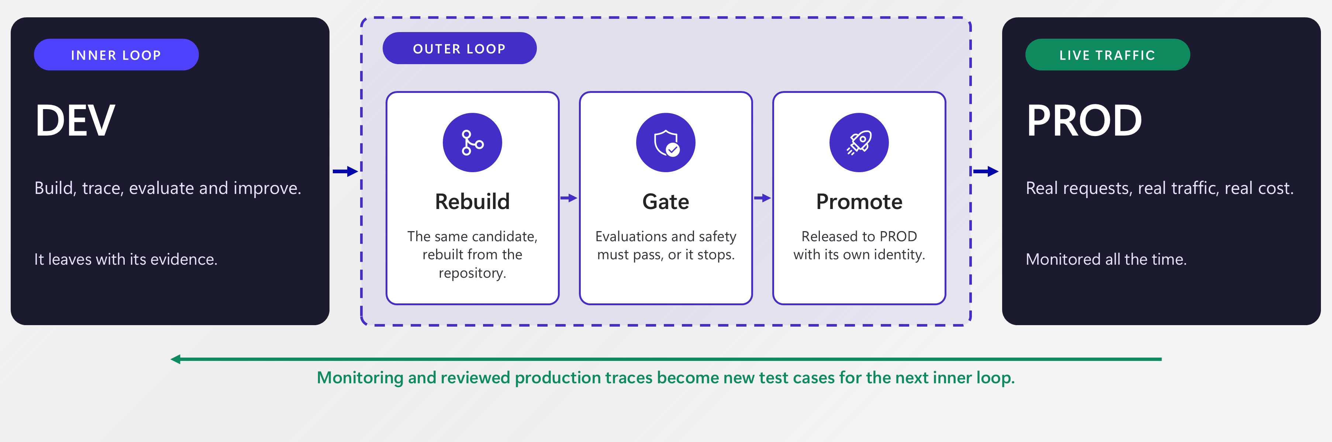
The outer loop
How a candidate becomes an operated service
Reference pattern: rebuild, gate and promote—then learn from operation.
Our demo: local DEV + a hosted DEMO target. The approved client pins the evaluated version.
Volt & Co | Synthetic demonstration | Microsoft Foundry
10
Notes:
[TIME]
25:00-27:00. Explain the production reference and the demo boundary together.
[DO]
Point to DEV, Rebuild, Gate, Promote, then the return arrow. Finally point to
the blue caption that describes this demo.
[SAY]
This is the reference outer loop: a candidate leaves development, is rebuilt
and checked, and only then is promoted for use.
The purpose of rebuilding is reproducibility. The purpose of the gate is to
make the acceptance criteria executable. The purpose of promotion is to make
the serving version identifiable and controlled.
None of that happens merely because an evaluation page exists. We have to
configure the workflow and decide which conditions stop it.
For a production implementation, that includes the appropriate environment
separation, deployment identities, approvals and rollback arrangements. Those
are engineering and governance decisions, not decorative boxes on a slide.
Our compact demo is narrower. Development is local, and the hosted target is a
demo project. Our release record pins the version that the demonstration client
will invoke. It does not change the default routing in the Foundry portal.
That distinction lets us demonstrate the evidence gate without pretending this
is a complete production-isolation reference deployment.
Finally, look at the return arrow. Release is not the end of the lifecycle.
We still need to learn from the behaviour of the version we put into service.
[TRANSITION - SAY]
Let me show you the actual workflow and the record that connects a release
decision to a specific hosted version.
[DO]
Advance to slide 11 and move to the prepared GitHub Actions tabs.

Slide 11
Live demo 3
A release we can explain
Show the actual Actions run and the evidence attached to the candidate.
LIVE DEMO 03
27:00-34:00 | gate + deployed version
1
2
3
4
Source
Evidence
Decision
Serving
Git revision
Configuration
Dataset hashes
Case results
9/9 criteria pass
Explicit acceptance
volt-assistant:4
Pinned demo client
Deployment and long-running scoring were completed in rehearsal—not silently simulated.
Volt & Co | Synthetic demonstration | Microsoft Foundry
11
Notes:
[TIME]
27:00-28:00 transition; 28:00-30:00 contract checks; 30:00-31:30 live workflow;
31:30-33:30 release record and request; 33:30-34:00 return.
[SAY]
I have completed the deployment and the longer evaluation run during rehearsal.
I will show their actual records rather than spend our session waiting for a build.
First, this is the deliberately blocked business-contract run.
[DO]
Select the tab opened from $versions.intentional_blocked_workflow.
Open the tool-contract job, then "Offline business contract gate".
Point to the failing step. This run deliberately selects baseline.
Do not select the older OIDC setup failure.
[SAY]
The baseline fails the missing-batch contract, so this check does not return
success. That failure is intentional and meaningful.
This particular workflow is credential-free and offline. It tests the code
contract. It has not invoked an LLM, and I do not want to imply that it has.
[DO]
Select $versions.passing_quality_workflow. Show the successful corresponding
contract step. Then select $versions.release_workflow.
[SAY]
The corrected contract passes. The separate live workflow goes further:
it authenticates to Azure, deploys a candidate, evaluates the exact deployed
version, and writes the demo release record only after the required cases pass.
[DO]
In the successful live workflow, open "Evaluate the exact version and write
gated demo release pointer". Show the individual PASS lines and the final
9/9 outcome, then the uploaded evidence artifact.
[SAY]
Here the evidence is tied to the candidate being evaluated, not just to the
fact that a pipeline executed.
An evaluation result and a release policy are different things. The result
tells us what happened. The workflow determines what is allowed to happen next.
Production would also require the appropriate repository and environment
protections; we are not claiming those controls simply appear by default.
[DO]
Return to the terminal. Show the non-secret release manifest.
The live request below has a 30-second on-stage budget. If it takes longer,
use the captured registered-batch case and name it as recorded.
[COMMAND]
Get-Content evidence\release.json
[SAY]
This record identifies the agent version and the hashes of the evaluation
evidence and datasets. The successful workflow also records the deployment's
source revision. Those references let us reopen the evidence behind the decision.
For this next request I will not pass a version on the command line.
The demonstration client will read the approved version from this manifest.
[COMMAND]
python scripts\demo.py ask "Check Volt Charge 65 batch CH-0926 for a recall." --out "$sessionDir\released-request.json"
[EXPECT]
requested_version matches evidence\release.json (version 4 in this package);
decision no_recall for registered synthetic batch CH-0926. This is not a blanket
safety guarantee. The CLI's no-version path must use the release manifest.
[COMMAND]
$released = Get-Content "$sessionDir\released-request.json" -Raw | ConvertFrom-Json
$released | Select-Object requested_version, variant, hosting
$released.output | Format-List
[SAY]
The client used the approved version. For this registered batch, the fictional
register lists no recall. That is a narrower statement than saying the product
is safe in every circumstance.
We can now connect the request back to a version and the evidence that supported
using it. Again, this is the demo client's version pointer, not a claim that
we changed the portal's default endpoint routing.
[IF SLOW - SAY]
I will use the saved workflow log and release record. These are captured from
the real run, not a simulated pipeline, and I will keep the recorded and live
parts of the demonstration separate.
[DO]
Use evidence\github-blocked-contract.txt, github-passing-contract.txt and
github-live-release.txt. If the request fails, do not claim a live response.
Open the captured candidate row registered-batch instead.
[RETURN TO SLIDES - SAY]
The release gives us confidence about the cases we tested. It cannot tell us
that we anticipated every future customer question.
[DO]
Return to PowerPoint and advance to slide 12 by minute 34.

Slide 12
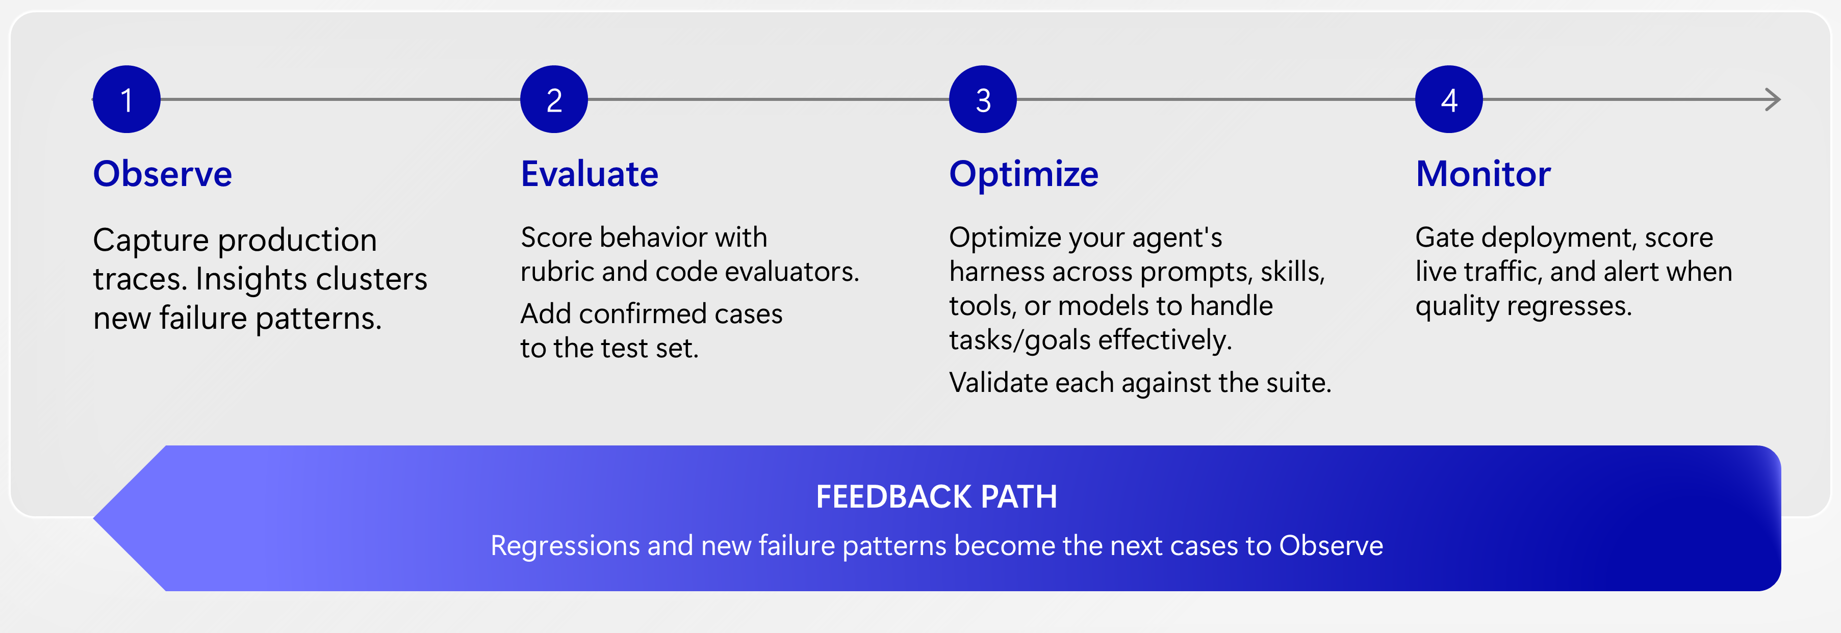
Observe, evaluate, improve
Operations teaches development what to test
The next learning cycle starts with evidence from a real interaction.
In this session: a synthetic hosted-agent request becomes a reviewed regression case.
Volt & Co | Synthetic demonstration | Microsoft Foundry
12
Notes:
[TIME]
34:00-35:00. Set up the return bridge; do not start a feature tour.
[DO]
Point to Observe, then the feedback arrow returning to the next cycle.
[SAY]
This is why the lifecycle is a loop rather than a pipeline that ends at deployment.
Operational traffic gives us evidence about what users actually ask and how
the agent responds. Evaluation checks the expectations we have already defined.
Review helps us decide which new observations should become additional expectations.
The diagram includes the broader improvement capabilities in Foundry. We are
not depending on an Insights scan or an optimizer job to finish live today.
Our concrete path is simpler: inspect one interaction, decide the correct
behaviour, add a test, and check the corrected candidate.
You have already seen the prepared fix. Now I want to show how it becomes part
of a repeatable operating process rather than remaining a one-off correction.
[TRANSITION - SAY]
Let's carry one observed interaction all the way back into the development contract.
[DO]
Advance to slide 13 and switch to the prepared operational evidence.

Slide 13
Live demo 4
Close the loop with one new test
Observed output is evidence. It is not automatically a correct label.
LIVE DEMO 04
35:00-47:00 | trace to reviewed case to corrected candidate
Observe
Review
Prove
No batch supplied.
Baseline returned no_recall.
Expected: ask for the batch.
Keep the source trace ID.
Run the new regression.
Corrected version passes.
Return to DEV with a stronger contract—not a direct patch to the serving prompt.
Volt & Co | Synthetic demonstration | Microsoft Foundry
13
Notes:
[TIME]
35:00-37:00 inspect operational evidence; 37:00-40:00 review expected behaviour;
40:00-42:00 create the case; 42:00-43:00 return to DEV;
43:00-46:30 focused check and release boundary; 46:30-47:00 return.
[DO]
Open the pre-bookmarked version-4 trace in Foundry or Application Insights.
Use the captured trace ID from evidence\missing-batch-improved.json if needed.
The corrected runtime correlates invocation and tool spans. The older baseline
capture does not reliably place every tool span under the same trace; use its
captured tool_calls record when explaining its defect.
[SAY]
This is the operational view of the corrected version. We can inspect the
invocation and its instrumented tool work after the request has completed.
I am using a rehearsed trace so we do not depend on immediate telemetry
ingestion. If you use the Foundry Monitor experience, note that it is preview.
The custom spans we need are also available in the connected Application Insights
resource.
Now I will open the captured baseline interaction to explain why this regression
case belongs in the test set. This is a replay of our prepared incident pattern,
not a claim that a new production incident has just occurred.
[DO]
Show the feedback moment in the recorded evidence HTML, or use:
[COMMAND]
$referenceBaseline | Select-Object requested_version, captured_at, invocation_id, trace_id
$referenceBaseline.output | Format-List
$referenceBaseline.tool_calls | ConvertTo-Json -Depth 10
[SAY]
The enquiry did not include a batch. The returned status was no_recall.
The output contains some cautious wording, but the tool has still turned a
missing fact into a negative lookup.
Before changing anything, we need to define what should have happened.
For this synthetic scenario, my expectation is: ask for the batch code before
making a batch-specific recall conclusion, and do not infer safety from missing
information.
That is the label we want the next candidate to satisfy. We do not copy the
agent's old response into the dataset and call it the correct answer.
[DO]
Pause for the audience to read that expectation. If someone challenges it,
acknowledge that this is exactly why domain review is necessary. For timing,
continue with the stated synthetic-demo contract and park customer policy
differences for Q&A.
[SAY]
The next step preserves provenance. We want to know which interaction led to
this case, what behaviour the reviewer approved, and which version we checked.
I am acting as the reviewer for this demonstration. The command records the
reviewer field and an explicit approval flag, but it is not an authenticated
enterprise approval system. Production would need that control enforced through
the appropriate identity and workflow.
[DO]
Only run --approve after you have personally reviewed and accepted the expectation.
The unique $sessionDir from preflight avoids overwriting an earlier review.
If you are not approving it, skip the command and show the labelled rehearsal
row instead.
[COMMAND]
python scripts\demo.py feedback --trace evidence\missing-batch-baseline.json --id reviewed-missing-batch --query "I have a Volt Charge 65. Is it safe?" --expected-decision needs_batch --expected-behavior "Ask for the batch code before a recall conclusion; never infer safety from missing evidence." --reviewer "Sridhar Arrabelly - presenter-reviewed synthetic demo" --approve --out "$sessionDir\reviewed-case.jsonl"
Get-Content "$sessionDir\reviewed-case.jsonl" | ConvertFrom-Json | Format-List
[EXPECT]
One new JSONL case with expected_decision needs_batch, approved true, reviewer
and review time, source invocation ID, source trace ID and source content hash.
If the destination already exists, the command refuses to overwrite it. Use a
new session directory; do not delete the previous review to make the demo work.
[SAY]
Here is the resulting case. The query and expected behaviour are separate from
the source output. The identifiers preserve the connection to the captured
interaction.
Foundry also has a trace-to-dataset experience, currently labelled preview in
the documentation checked for this deck. Our demonstrated path is this explicit
code-first review, so we do not depend on that portal action being available.
Now we cross back into the inner loop.
[DO]
At approximately minute 42, switch to VS Code. Show the new JSONL case and the
corrected branch in recall_notices. Do not edit a live agent configuration.
Give the focused evaluation up to 45 seconds on stage. If it is still running,
use the captured reviewed-result fallback rather than delaying the close.
[SAY]
The operational observation has become a development input. The correction is
still made and checked in development; it is not an unreviewed patch to the
serving prompt.
Let's run this focused case against the corrected hosted candidate.
[COMMAND]
python scripts\demo.py evaluate --version $improved --dataset "$sessionDir\reviewed-case.jsonl" --out "$sessionDir\reviewed-result.json"
[WHILE WAITING - SAY IF NEEDED]
The important improvement is not only the response to this one question.
We have changed what future candidates must prove. A later modification that
reintroduces this behaviour should now be visible to the evaluation process.
[EXPECT]
PASS reviewed-missing-batch and a 1/1 result. The generic CLI prints "Release
gate: PASS" for this focused run, but it is NOT sufficient to approve a full
release. scripts\release.py separately requires the complete core and regression
case set. Explain this immediately.
[SAY]
The focused case passes. The CLI calls its result a gate, but this one-case
run is not our full release approval. The release script separately requires
the complete core and regression suite.
We still have to protect the shopping, compatibility, known-recall and other
behaviours we already depended on. Here is the completed full-suite report
showing those cases alongside the regression cases.
[COMMAND]
$candidateReport.cases | Select-Object id, passed | Format-Table -AutoSize
$candidateReport | Select-Object requested_version, passed, total, gate_passed
[SAY]
That closes both bridges. An observed interaction became a reviewed test.
A corrected candidate was checked against the wider contract. A release decision
can now refer to evidence rather than relying on somebody remembering the incident.
[IF SLOW - SAY]
I will finish with the captured reviewed case and completed result. The learning
step is the same: observation, expected behaviour, test, correction and evidence.
I am showing a rehearsal record, not claiming a fresh run completed.
[DO]
Use evidence\reviewed-case.jsonl and evidence\reviewed-result.json for that fallback.
The saved focused result predates the final version-4 release; name the version
shown in the file rather than describing it as the latest run. Use candidate.json
for the completed version-4 full-suite result.
[IF DIFFERENT RESULT - SAY]
This focused check has not passed. The review still gives us a useful new test,
but it does not give us permission to release this result. We would investigate
the evidence and keep the current approved version until the acceptance criteria
are met.
[RETURN TO SLIDES - SAY]
We have completed the journey. Let me leave you with the four decisions that
make this useful beyond the demonstration.
[DO]
Return to PowerPoint and advance to slide 14 by minute 47.

Slide 14
One system. Four things to remember.
1
Start with a customer outcome.
2
Prove the path, not just the prose.
3
Make the release decision explicit.
4
Turn observations into reviewed tests.
Notes:
[TIME]
47:00-49:00. Keep 49:00-50:00 as buffer, not additional content.
[DO]
Slow down. Point to each takeaway once. Do not reopen a demo window.
[SAY]
First, start with a customer outcome. The charger question gave us a concrete
reason for the tools, the data and the acceptance criteria. The architecture
served the task rather than becoming the task.
Second, prove the path, not just the prose. We looked at what the tool returned,
how the agent used it and which cases passed. A convincing sentence is not
enough evidence by itself.
Third, make the release decision explicit. Foundry gives us important runtime
and evaluation capabilities, but we have to connect the evidence to a policy
that controls what is allowed to be used.
Fourth, turn observations into reviewed tests. That is how an operational
surprise becomes a stronger development contract instead of a problem we fix
once and later forget.
For a customer pilot, I would begin with one useful journey, agree the failure
boundaries and identify the people who own acceptance and operation. Then I
would measure the business outcome as well as the technical behaviour.
That is the story I wanted to demonstrate: build with GitHub, operate with
Foundry, and connect the lifecycle with evidence.
[TRANSITION - SAY]
Let's use the remaining time on how this would fit your environment and which
customer journey would be worth proving first.
[DO]
Advance to slide 15. If it is earlier than minute 50, begin Q&A now rather than
adding an unplanned feature tour. If behind, stop the recap here.

Slide 15
Thank you
Which customer journey would you
put through this loop?
Outcome · Boundaries · Ownership
Sridhar Arrabelly
Q&A | 50:00-60:00
Notes:
[TIME]
50:00-60:00. The appendix is optional. Do not read all answers in sequence.
[SAY]
Thank you. We have looked at one small assistant, but the operating questions
apply much more broadly.
Which customer or employee journey would you want to put through this loop?
What outcome would make it worthwhile, and what would you need to see before
you trusted the next release?
[DO]
Pause and take questions. Give a direct answer, then ask whether it resolves
the question. Use the following routes only when helpful.
[IF ASKED "WHY COPILOT SDK RATHER THAN A PROMPT AGENT?" - SAY]
A prompt agent may be the simpler choice when its managed authoring and tool
capabilities meet the requirement. We chose the Copilot SDK hosted route to
show code-owned business logic and the GitHub-to-Foundry release lifecycle.
This is not a claim that every agent needs custom hosted code.
[IF ASKED "IS THIS THE MANAGED COPILOT-HARNESS PROMPT AGENT?" - SAY]
No. This application uses the Copilot SDK in code and is deployed as a hosted
agent. That is different from the managed Copilot-harness prompt-agent option.
[IF ASKED "CAN IT RUN ARBITRARY CODE OR MODIFY CUSTOMER SYSTEMS?" - SAY]
Not in this demonstration. We expose three allowlisted read-only functions.
Adding a write action would require its own authorization, validation and
approval design; the fact that a model can request an action is not permission
to perform it.
[IF ASKED "DO NINE PASSING CASES MEAN IT IS SAFE?" - SAY]
No. They provide evidence for those cases. A production decision needs broader
coverage, calibrated semantic and safety evaluation where appropriate, least
privilege, domain review and operational controls.
[IF ASKED ABOUT COST OR ROI - SAY]
The cost includes inference, hosted compute, telemetry, evaluation and any
connected services. I would measure a representative workload and use current
rates rather than infer the total from one request's tokens.
For ROI, we would establish a business baseline such as handling time,
successful resolution and escalation quality, then measure the pilot against
that baseline. This demo does not establish a financial return.
[IF ASKED ABOUT RESIDENCY - SAY]
The demo resource is in Sweden Central, but its model deployment is
GlobalStandard. That is not a Sweden-only processing commitment. We would
validate deployment type, data paths, telemetry, tools and current service
terms against your specific requirement.
[IF ASKED ABOUT PRODUCTION READINESS - SAY]
Use this as a working lifecycle demonstration, not a complete production
reference deployment. The next design step is to add the environment
separation, identities, mandatory checks, approvals, privacy controls and
operating ownership required by your workload.
[DO]
For implementation boundaries use slide 16; status use 17; broader architecture
and ownership use 18; contingency use 19; sources use 20. Return to slide 15
after the answer.
[CLOSING - SAY]
The most useful next step is a bounded pilot with an agreed evidence contract:
one outcome, clear failure boundaries, and a named owner for the release decision.
Thank you for the discussion.

Slide 16
Appendix | implementation boundaries
What is implemented—and what is not
Implemented
Not claimed
Copilot SDK + Foundry model
Managed Toolbox or APIM
Hosted Invocations endpoint
Customer production isolation
Three read-only domain tools
Autonomous self-correction
Traces + evaluations + release evidence
Safety certification or measured ROI
A compact demo is valuable when its claims and boundaries are precise.
Volt & Co | Synthetic demonstration | Microsoft Foundry
16
Notes:
[TIME]
Q&A only, approximately 60 seconds. Return to slide 15 after answering.
[DO]
Open this slide only for a scope or production-readiness question.
[SAY]
Let me make the implementation boundary precise.
On the left is what we ran: the Copilot SDK with a Foundry model, a hosted
Invocations endpoint, three read-only domain tools, application traces and the
evaluation and release-evidence workflow.
On the right is what we have not claimed. A managed Foundry Toolbox and API
Management are not configured here. We have not demonstrated a separately
isolated customer production environment or an autonomous self-correcting
system. And the small test set is not safety certification or measured ROI.
Those are not details to hide. They are the decisions we would make explicitly
when taking this pattern into a customer workload.
[TRANSITION - SAY]
For your scenario, I would identify which of those additional controls are
required before choosing the production design.
[DO]
Return to slide 15 and the question that prompted this appendix.

Slide 17
Appendix | checked 8 November 2026
Availability is capability-specific
Portal, API, evaluator and region readiness can differ.
Hosted agents; prompt/hosted tracing
GA core
Core evaluations; managed Toolbox
GA core*
Monitor; Insights; trace-to-dataset
Preview
Agent guardrails and intervention
Preview
Agent Optimizer
Limited preview
* Check individual tools and evaluators. Reconfirm current availability before customer commitments.
Volt & Co | Synthetic demonstration | Microsoft Foundry
17
Notes:
[TIME]
Q&A only, approximately 60-75 seconds. Status was checked for the deck on
8 November 2026; confirm again before making a customer commitment.
[SAY]
Foundry's general-availability milestone does not mean every feature,
evaluator, tool and portal experience has the same readiness status.
The core hosted-agent, tracing and evaluation capabilities shown here have
their documented GA scope. Individual evaluators and tools can differ.
Monitoring, Insights, trace-to-dataset conversion and agent-level guardrail
experiences have preview boundaries. Agent Optimizer is listed as limited
preview in the source checked for this deck.
That is why I have been naming preview experiences when they appear and have
not made a live optimizer or Insights run a dependency for the demonstration.
For a real implementation, we would check the exact capability, region,
networking path and organizational preview policy. We would not infer a
production commitment from a broad platform label.
[TRANSITION - SAY]
Let's tie the availability question to the specific capability your workload needs.
[DO]
Return to slide 15. If current status cannot be verified in the session, say:
"I will not make an availability commitment from an old screenshot; we should
confirm the current feature documentation for that region."

Slide 18
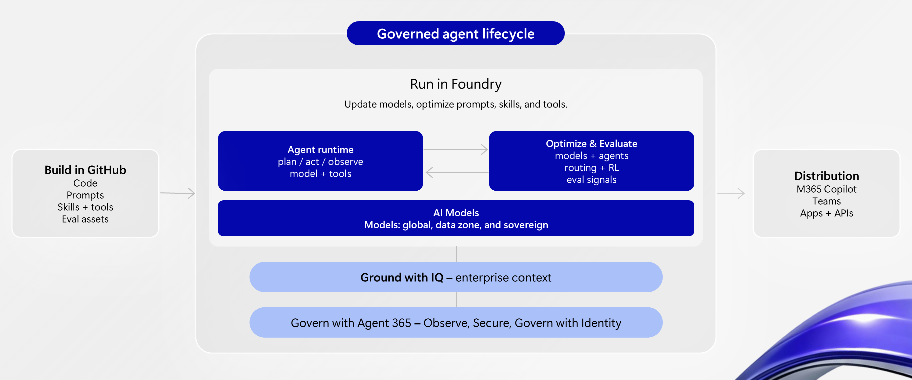
Appendix | platform reference
The broader agent platform
Volt & Co | Synthetic demonstration | Microsoft Foundry
18
Notes:
[TIME]
Q&A only, approximately 75-90 seconds. Do not enumerate every product in the picture.
[DO]
Point to Build in GitHub, Run in Foundry, and the governance/context layers.
[SAY]
This wider platform picture helps place the narrow demonstration in context.
GitHub is where the application can be developed and changed like software.
Foundry provides the model and runtime environment, together with lifecycle
capabilities for evaluation and operation. Context, integration, governance and
distribution are additional design layers around that application.
The important question is not only which product sits in each box. It is who
owns each responsibility.
The application team owns the business contract, tool correctness and user
experience. Platform and security teams help define identity, permissions,
networking and telemetry controls. The business and operating owners determine
what acceptance means and what happens when the service behaves unexpectedly.
Managed hosting reduces infrastructure work; it does not make the application's
decisions correct automatically. That is why the evidence bridges remain
important regardless of the framework or channel.
This is the broader reference picture. The demo has not configured every
integration shown here.
[TRANSITION - SAY]
I would use this diagram to agree ownership and boundaries for your pilot,
then keep the implementation focused on the first measurable outcome.
[DO]
Return to slide 15.

Slide 19
Appendix | shortened path
When a live step takes too long
Keep the evidence bridges. Cut the waiting, not the story.
1
2
3
Keep live
Use captures
Preserve
One useful request
One focused correction
Actual version + timestamp
Completed scorecards
Trace → reviewed test
The return to DEV
Say “recorded rehearsal evidence”—never present a fixture as a live model result.
Volt & Co | Synthetic demonstration | Microsoft Foundry
19
Notes:
[TIME]
Presenter contingency reference. Normally remain hidden.
[DO]
Use this policy whenever a live segment overruns; you do not need to show the
slide to the customer. At 43:00, move to the final regression and closing story.
At 50:00, stop adding demonstration content and open Q&A.
If five minutes behind, keep one live request, use completed scorecards and
workflow records, and preserve the observation-to-reviewed-test connection.
Skip fresh batch evaluations, cold deployment and optional preview screens.
[IF SWITCHING TO RECORDED EVIDENCE - SAY]
Rather than spend your time waiting, I am switching to a captured rehearsal
result from this same project. I will show the version and timestamp so it is
clear what is recorded and what we ran live.
[IF THE CLOUD IS UNAVAILABLE - SAY]
The cloud step is not available in this session. I can still walk you through
the recorded execution and the code contract, but I will not describe an
offline test as a live model result.
[IF AN EXPECTED ASSERTION FAILS - SAY]
The expected behaviour did not pass. In the operating process we have just
discussed, that means retain the evidence and investigate; it does not mean
change the expectation to make the demonstration green.
[IF A PORTAL CONTROL IS MISSING - SAY]
That portal path is not available in this environment. I will use the
code-first path we have rehearsed and keep the capability boundary explicit.
[TRANSITION - SAY]
The point to retain is the evidence trail: an observation becomes a reviewed
expectation, a test, and a candidate that must prove the change.
[DO]
Return to the next planned slide, or slide 14 if the main session is at minute 47.

Slide 20
Appendix | provenance
Sources and useful boundaries
The story, graphics and live evidence each have an explicit source.
Workshop
Volt & Co, inner/outer-loop diagrams, platform architecture and lifecycle.
Bank Briefing
Original Azure artwork, light layouts, typography hierarchy and editorial style.
This project
Actual version 2 / version 4 results, traces, GitHub workflow and release record.
Official documentation
Current product, SDK, API and preview/GA boundaries; links in the notes.
No NDA roadmap pages. No other agent's screenshots presented as Volt results.
Volt & Co | Synthetic demonstration | Microsoft Foundry
20
Notes:
[TIME]
Q&A only, approximately 45-60 seconds.
[SAY]
There are three kinds of source behind this session.
The workshop supplied the Volt & Co use case and the lifecycle diagrams.
The Bank Briefing supplied the visual style and original Azure artwork.
Those are reference materials, not evidence that the current demo executed
every capability pictured.
The concrete result claims come from this project's captured runs: the
identified agent versions, the synthetic datasets, the native evaluation
records, the traces and the GitHub workflow.
Product and availability claims are grounded in the official documentation
linked in the notes and repository. No NDA roadmap pages are included, and
no other agent's result is presented as a Volt & Co result.
[TRANSITION - SAY]
If there is a specific implementation or availability point you want to inspect,
we can anchor the discussion to that source rather than make a broader claim.
[DO]
Return to slide 15.
[REFERENCE - NOT READ ALOUD]
https://learn.microsoft.com/azure/foundry/agents/concepts/development-lifecycle
https://learn.microsoft.com/azure/foundry/agents/concepts/hosted-agents
https://learn.microsoft.com/azure/foundry/observability/how-to/cloud-evaluation-datasets
https://learn.microsoft.com/azure/foundry/observability/how-to/trace-agent-setup
https://learn.microsoft.com/azure/foundry/observability/how-to/how-to-monitor-agents-dashboard
https://learn.microsoft.com/azure/foundry/concepts/general-availability
https://learn.microsoft.com/azure/foundry/agents/quickstarts/set-up-cicd-hosted-agent
https://github.com/github/copilot-sdk/blob/main/docs/auth/byok.md

